Slide 1
Kubernetes: From container orchestration to self-contained application platform
Anton Sankov
Member of Technical Staff @ VMware Carbon Black

Slide 2
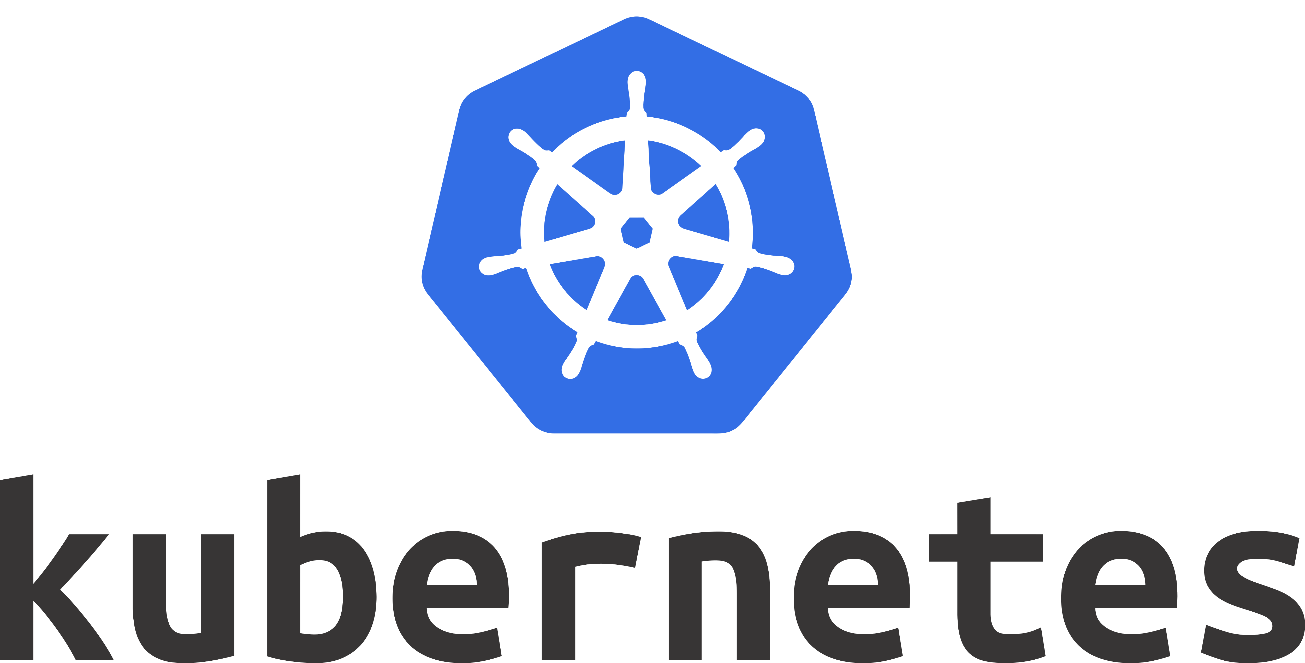
Kubernetes
Open-source Container orchestration tool.
The de-facto standard for deploying applications in 2021.
But can it be more than that? YES!
https://github.com/kubernetes/kubernetes/

Slide 3
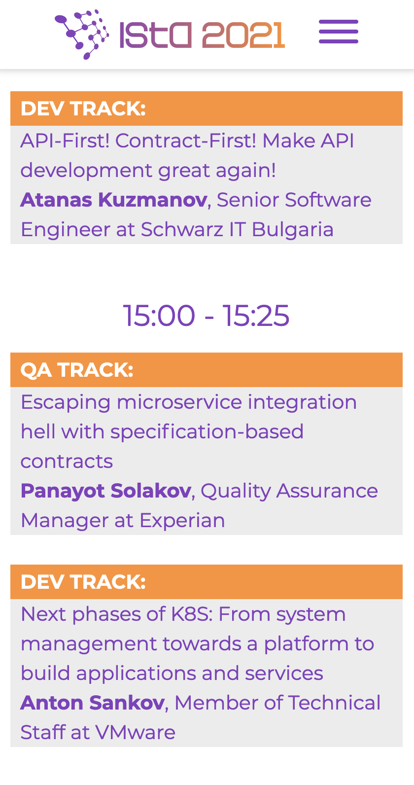
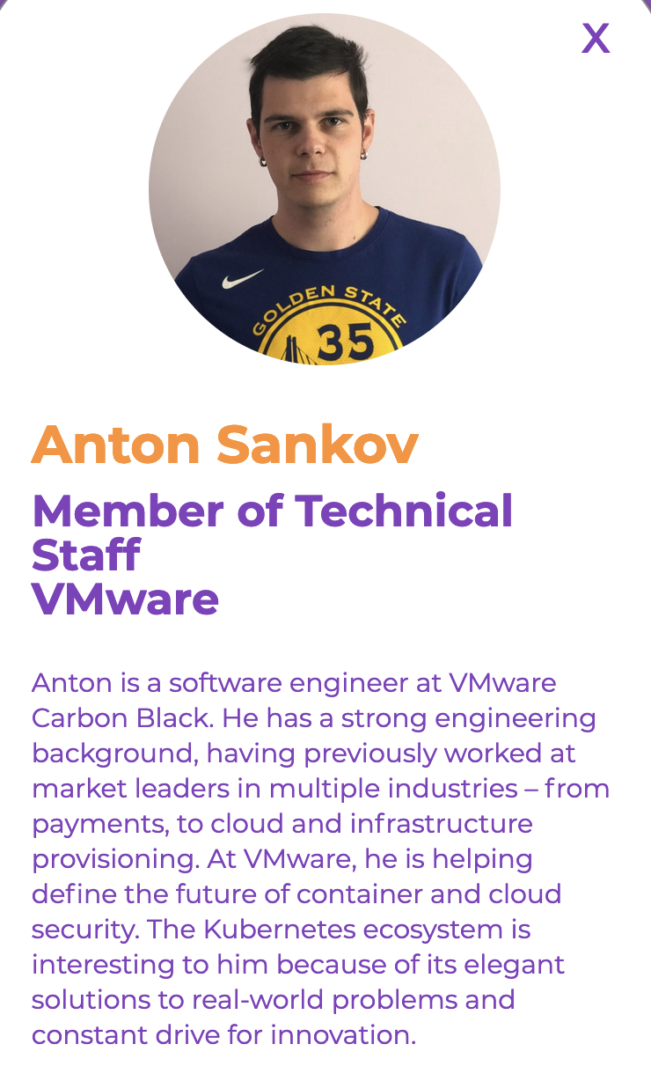
What are we going to build ?
A conference management system.
Conference talks:
Title
Summary
Speaker
Speaker
Name
Bio

Slide 4
How are we going to build it?
CRUD API backend
to Create/Read/Update/Delete resources
Database
to store the resources
Simple UI
to visualize the resources

Slide 5













What is the standard way to build this?
… and many more

Slide 6
What are the challenges to build it the standard way?
Framework for the API backend – pros and cons
No guidelines on how to manage your API
- documentation
- versioning

Slide 7
What is the alternative?
API backend build entirely by extending Kubernetes.
Kubernetes is flexible and extensible.
Use Kubernetes extensibility constructs – CRDs, Admission Controllers, Operators

Slide 8
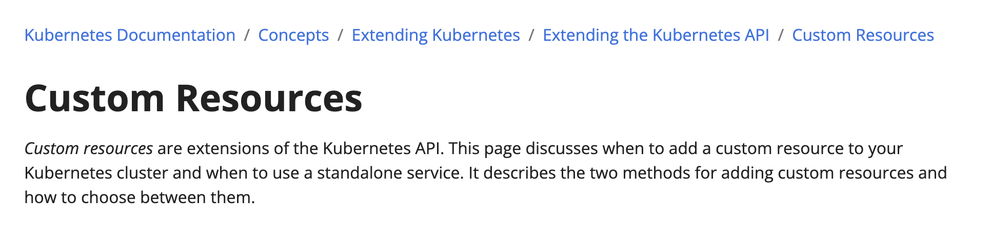
Domain objects are CRDs
CRD - Custom Resource Definiton
https://kubernetes.io/docs/concepts/extend-kubernetes/api-extension/custom-resources/

Slide 9
CRDs in more technical terms
When creating a CRD Kubernetes registers new endpoints.
And provides implementation for these endpoints
Serialization/Deserialization
Validation based on the OpenAPI spec
Write/Read from DB
https://kubernetes.io/docs/concepts/extend-kubernetes/api-extension/custom-resources/

Slide 10
The Custom Resource Definitions which we will install into our cluster
https://kubernetes.io/docs/concepts/extend-kubernetes/api-extension/custom-resources/

Slide 11
The Custom Resources which are instances of the CRDs with actual data
kubectl apply –f kubernetes-talk.yaml
to create this conference talk
kubectl apply –f anton-sankov.yaml
to create this conference talk
https://kubernetes.io/docs/concepts/extend-kubernetes/api-extension/custom-resources/

Slide 12


Slide 13
What do we have so far?
CRUD API backend as an extension of Kubernetes API
Ability to Create/Read/Update/Delete resources via Kubernetes API
Resources automatically stored at the database

Slide 14



The (not so) big picture
creates
ConferenceTalk
writes to
kubectl apply –f …
reads
ConferenceTalk
reads from
kubectl get conferencetalks
Graphics:
https://github.com/kubernetes/community/

Slide 15
What if we have business logic?
More complex validations
- do a speaker with that ID exists?
- unique conference talk names
Actions on creation
- send an email when a conf. talk is created
- publish a social media post when a conf. talk is created

Slide 16
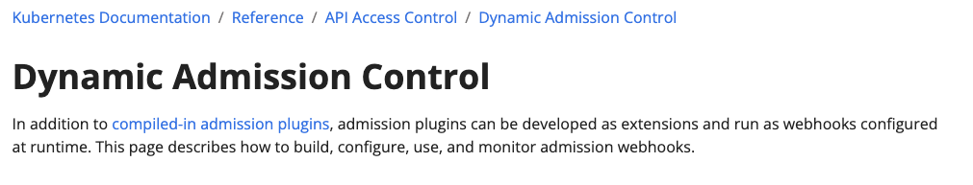
Admission controllers for validation
Admission controller – controller that allows or denies
a creation of a resource
https://kubernetes.io/docs/reference/access-authn-authz/admission-controllers/
https://kubernetes.io/docs/reference/access-authn-authz/extensible-admission-controllers

Slide 17
Admission controllers for validation
Receives the request before the resource is created
Allows or denies the creation of the resource
Many build-in admission controllers, capabilities to write our own
Perfect place for implementing our validation
https://kubernetes.io/docs/reference/access-authn-authz/admission-controllers/
https://kubernetes.io/docs/reference/access-authn-authz/extensible-admission-controllers

Slide 18
Admission controllers in more technical terms
Webhook called by Kubernetes
The response contains whether the request should be allowed or not
https://kubernetes.io/docs/reference/access-authn-authz/admission-controllers/
https://kubernetes.io/docs/reference/access-authn-authz/extensible-admission-controllers

Slide 19

The (not so) big picture
creates
ConferenceTalk
allows
writes to
admission controller
denies
❌
Graphics:
https://github.com/kubernetes/community/

Slide 20
What if we have business logic?
More complex validations
- do a speaker with that ID exists?
- unique conference talk names
Actions on creation
- send an email when a conf. talk is created
- publish a social media post when a conf. talk is created
✅

Slide 21
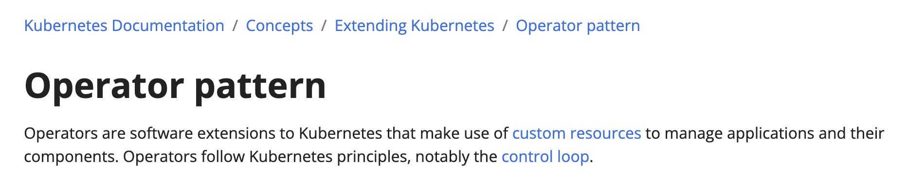
Operators for business logic
Operator – controller for custom resources
https://kubernetes.io/docs/concepts/extend-kubernetes/operator/

Slide 22
Operators for business logic
Listens for creation/update/deletion of a given CRDs
Runs come code on that event
Perfect place for implementing the business logic around our CRDs
https://kubernetes.io/docs/concepts/extend-kubernetes/operator/

Slide 23
Operators in more technical terms
Interacts with Kube API and listens for resource changes.
Can be generated based on the CRDs in any language
All the Kubernetes specific logic is generated, just write your business logic
https://kubernetes.io/docs/concepts/extend-kubernetes/operator/

Slide 24
What if we have business logic?
More complex validations
- do a speaker with that ID exists?
- unique conference talk names
Actions on creation
- send an email when a conf. talk is created
- publish a social media post when a conf. talk is created
✅
✅

Slide 25
The big picture
creates
ConferenceTalk
allows
writes to
admission controller
listens for
ConferenceTalks
denies
❌
operator
Graphics:
https://github.com/kubernetes/community/

Slide 26
Details worth mentioning
This solution uses etcd as a DB out-of-the-box.
This might not be the best idea.
For more complex use-cases you can use a “regular” DB (PostgreSQL, MySQL, etc.) provisioned in your cluster via an operator
https://etcd.io/docs/
https://postgres-operator.readthedocs.io/
https://blogs.oracle.com/developers/post/
introducing-the-oracle-mysql-operator-for-kubernetes

Slide 27
Details worth mentioning
A standard way to interact with Kubernetes is kubectl and yaml files.
Kubernetes exposes a REST API that kubectl wraps.
Your customers can use both kubectl and the HTTP REST API.
kubectl apply –f …
curl –d {…}

Slide 28



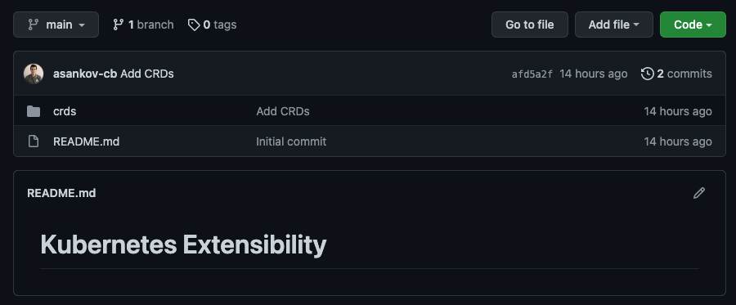
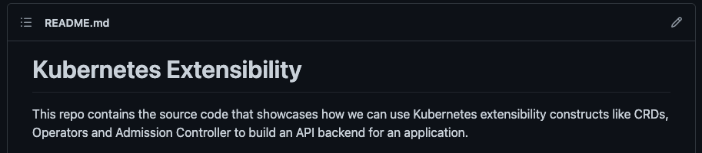
Talk is cheap, show me the code!
To see the full picture go to
https://github.com/asankov-cb/kubernetes-extensibility

Slide 29
Takeaways
There are many ways to build a web application.
New technologies motivated people to start building applications in new ways
This approach is currently popular for products that need to provision something in Kubernetes – databases, lifecycle management, etc.

Slide 30
Questions?
a_sankov
Anton Sankov
github.com/asankov-cb
asankov@vmware.com
Thank you!

